Slide 1
LUMIRA - VISUALIZE
Milind Parab

Slide 2
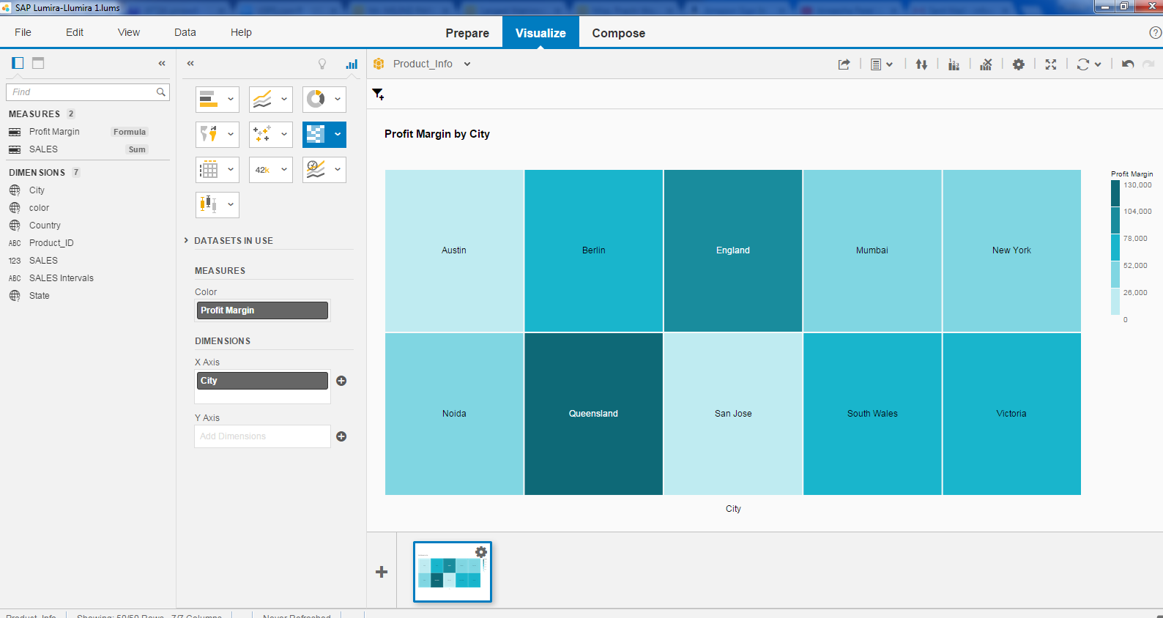
Heat Map for Profit Margin.

Slide 3
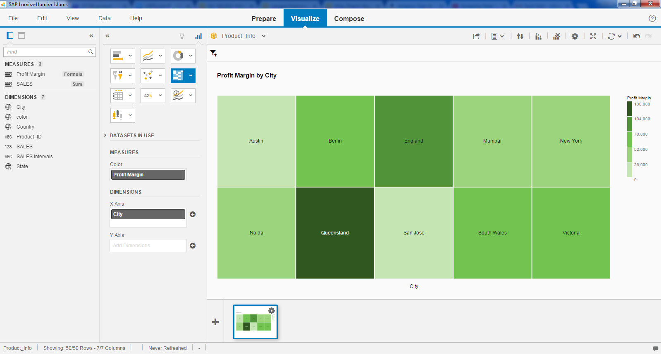
Change the color by click on empty space.

Slide 4
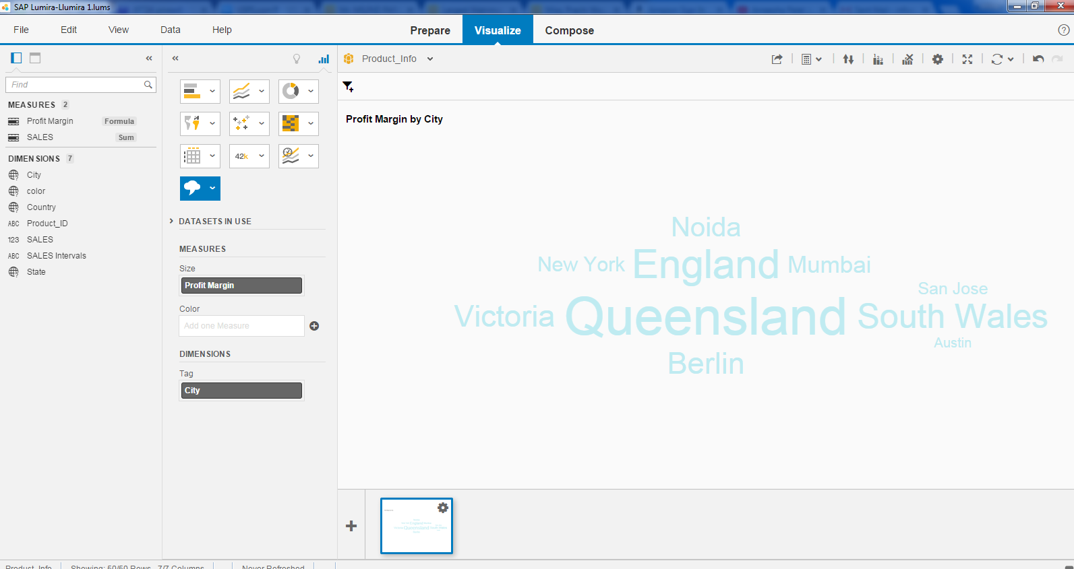
We can create Tag Cloud.

Slide 5
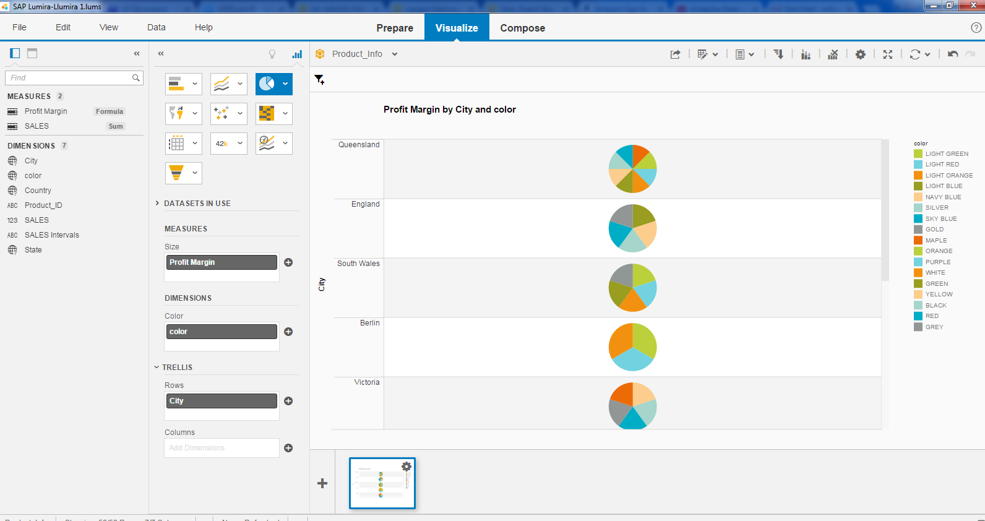
Pie Chart.

